Slide 1
Initial Methods Testing – Getting Expected BP Increase
Marko, with Nisha, Sanil, and Zach

Slide 2
Initial Methods Flow Chart
Walk all the way to the bottom of Leyburn, and all the way back pup to M42
Initial Sample Group of men (n = 1)
Measure resting HR
Measure Elevated HR
Calculate % of max HR
Figure 1: initial methods testing flow chart. This was used to gain an understanding of how walking the entire Leyburn
Stairs, from top to bottom, effects heart rate. Understanding the effects of on heart rate in healthy men allowed comparison with known data of BP increase.

Slide 3
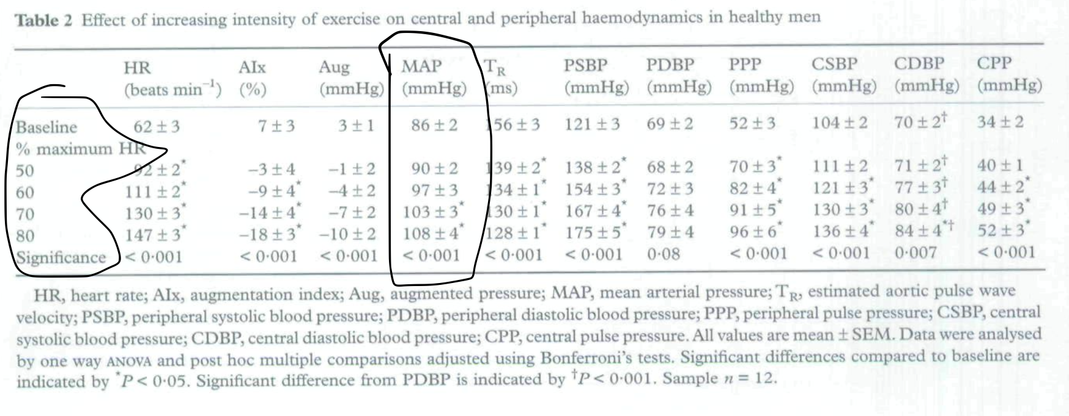
Comparing to known results
From this Table, we compare baseline HR to the % maximum HR achieved after conducting the method illustrated in Figure 1.
After walking up and down the Leyburn stairs the subject had reached roughly 70 % of max HR. Therefore, we expect MAP to
Increase by 17 mmHg

